Slide 1
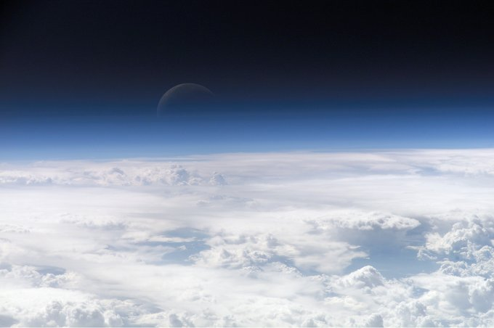



Slide 2

What is exosphere?
The exosphere is a thin layer of atmosphere.
where molecules are gravitationally bound to earth.
where the density is too low.
The exosphere is the uppermost layer of earth.
It is located directly above the thermosphere.

Slide 3
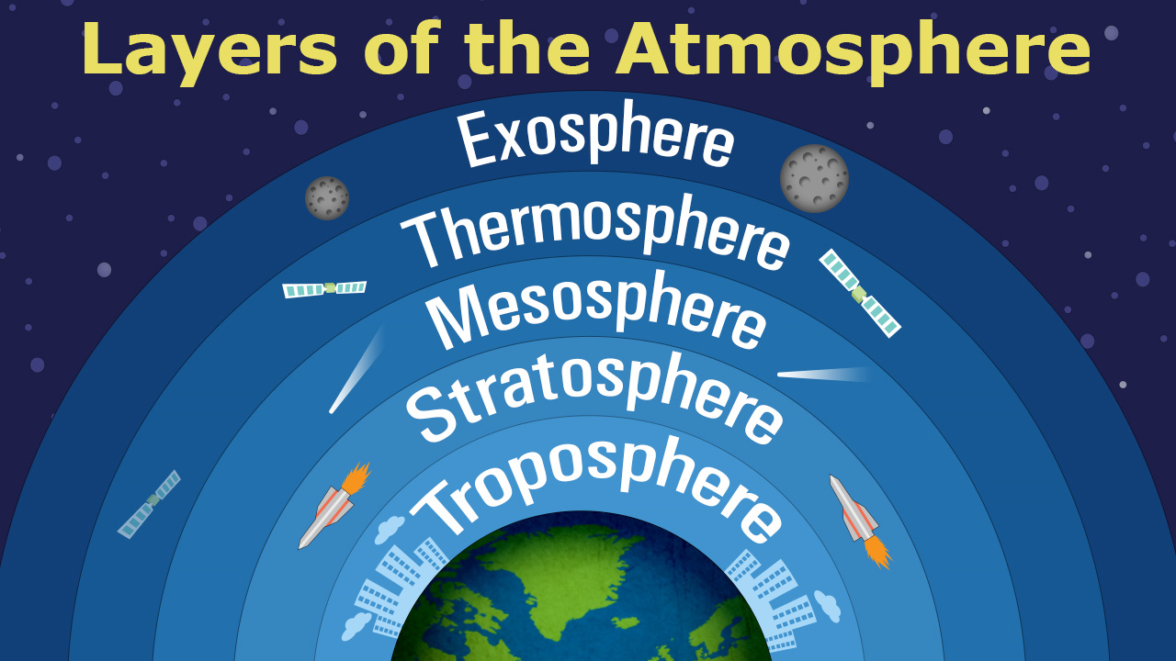
Where is it?

Slide 4
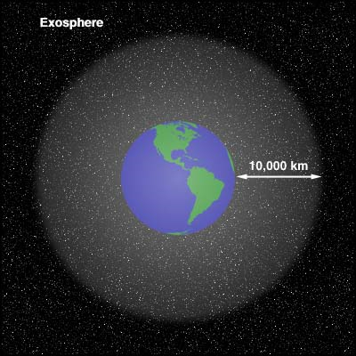
Fun facts!
The exosphere is perfect for placing satellites as there is very little friction and they are able to orbit fairly easily without being disrupted.
Although the exosphere is the most distance layer of earth's atmosphere it is the layer that is the planet's first line of defense against the sun's rays. It is also the first layer to come into contact and protect the earth from meteors, asteroids, and cosmic rays.
The temperature in the exosphere varies greatly and can range from 0 to over 1700 degrees Celsius. It is colder at night and much hotter during the day.

Slide 5

Fun Facts
The air in the exosphere is very thin, and is made up mostly of helium,
and hydrogen. Traces of other gases such as atomic oxygen and carbon
dioxide can also be found.
The upper level of the exosphere is the farthest point from earth that is
still affected by earth's gravity. However this distance would be halfway
to the moon, and is only considered to be true in a technical sense.

Slide 6


