Slide 1
Iodine
-by Kashvi Jain; Grade 6B

Slide 2
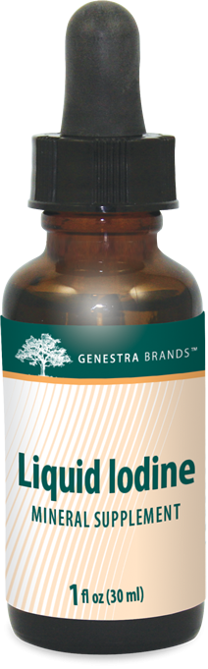
Iodine - Properties
Atomic Symbol: I
Atomic number: 53
Position in Periodic Table: group 17
Discovered: Year 1811
Melting point: 113.7 °C
Boiling point: 183 °C to form a violet gas.
Freezing point: 184 °C
Physical Stage: A non-metallic element forming black crystals and a violet vapour, which looks dark purple

Slide 3
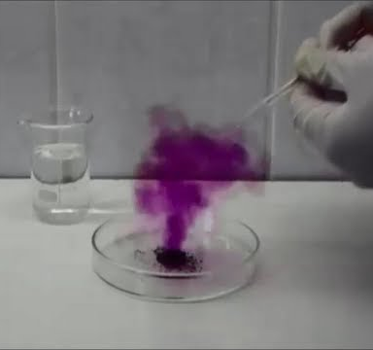
Discovery of Iodine
Iodine was discovered in 1811 by Barnard Courtois.
He named it iodine from the Greek word "iodes" which means violet.
Iodine is fairly rare in both the Earth's crust and in the solar system.
Iodine is the 47th most abundant element in the solar system.

Slide 4
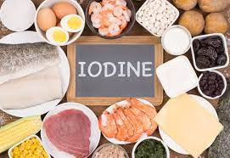
Iodine - Usage
Potassium iodide (KI) is used to make photographic film when it is mixed with iodine in alcohol
A solution of iodine in alcohol, used as a mild antiseptic
Iodine-131 is radioactive isotope of iodine
Used to treat some diseases of the thyroid gland
Iodine reduces thyroid hormone and can kill fungus, bacteria, and other microorganisms
A specific kind of iodine called potassium iodide is also used to treat (but not prevent) the effects of a radioactive accident
Care should be taken in handling and using iodine

Slide 5
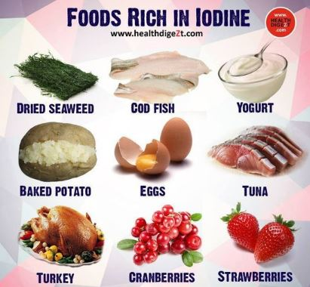
Iodine present in food substances

Slide 6
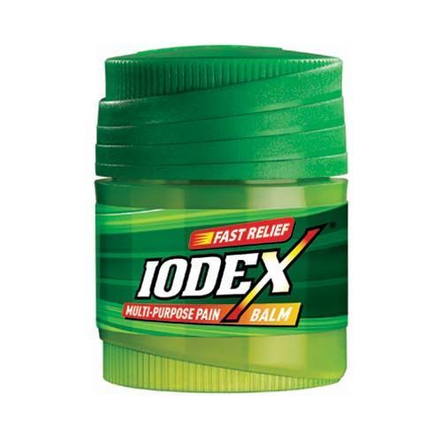

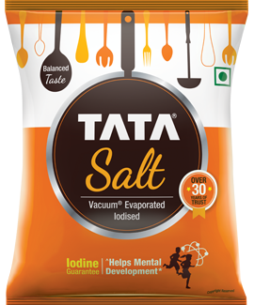
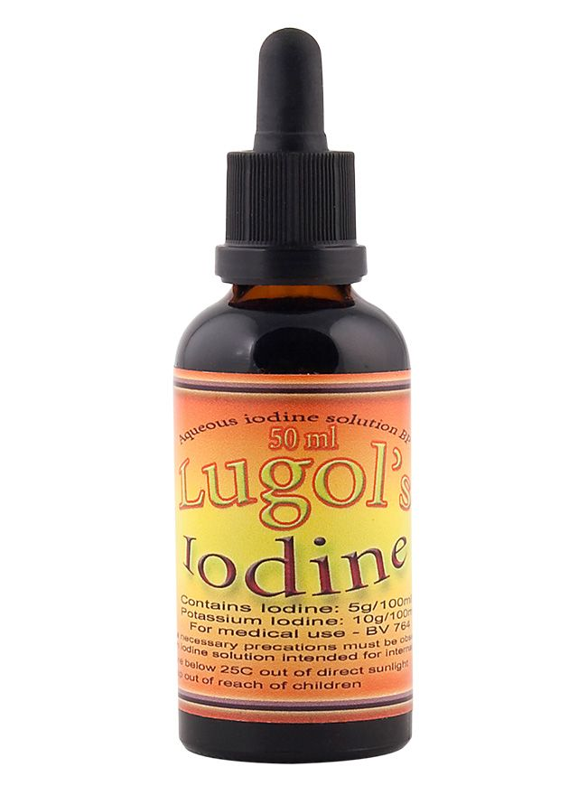
Popular brand using Iodine

Slide 7


